Slide 1


AI ARCHITECTURE OVERVIEW
Introduction to RAG
Retrieval-Augmented Generation: Empowering LLMs with External Knowledge Base Capabilities.
R
Retrieval
Fetches relevant context & documents from external vector stores.
A
Augmentation
Enriches user prompts with live factual data before model inference.
G
Generation
Produces grounded, highly accurate answers with reduced hallucination.

Slide 2


The Problem with Standard LLMs
1. Hallucinations
2. Stale & Private Data
LLMs are trained to generate text, not tell the truth. If you ask a standard model about events outside its training data, it will confidently make up false information (hallucinate) rather than admitting it doesn't know.
Models have a "knowledge cutoff" (e.g., trained up to August 2021). Furthermore, you cannot securely train a public LLM on internal, proprietary company data like HR policies or confidential finance reports.

Slide 3
What is RAG?
RAG is the process of optimizing the output of a large language model by referencing an authoritative knowledge base outside of its training data sources before generating a response.
"
"
— Core Definition

Slide 4

Why Not Just Fine-Tune the Model?
Feature
Fine-Tuning
RAG (Retrieval-Augmented Generation)
Cost & Effort
Extremely expensive and tedious.
Highly cost-effective and faster to implement.
Updating Knowledge
Requires retraining the model repeatedly.
Just drop new documents into the Vector DB.
Hallucination Risk
High (Model still relies on parameterized memory).
Low (Model relies on explicit retrieved context).
Use Case
Changing the model's tone, style, or format.
Adding factual, internal, or real-time knowledge.

Slide 5






The Two Core Pipelines of RAG
1. Data Ingestion
2. Retrieval
3. Generation
Preparing the knowledge base. This involves parsing documents (PDF, CSV), breaking them into chunks, creating vector embeddings, and storing them.
When a user asks a query, the system searches the stored vector embeddings to find the most relevant document chunks based on mathematical similarity.
The retrieved chunks (context) and the original user query are fed into an LLM via a prompt to generate an accurate, evidence-based answer.

Slide 6

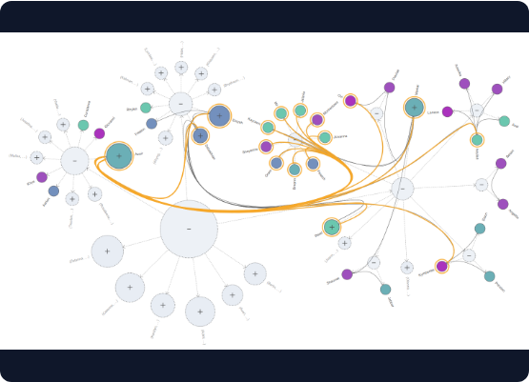
Step 1: Data Ingestion Pipeline
•
Parse the Data: Use loaders (like PyMuPDF) to read unstructured data (PDFs, internal wikis) and extract text and metadata.
•
Chunking: Divide large documents into smaller, manageable text blocks.
•
Generate Embeddings: Convert the text chunks into numerical vectors using models like Sentence Transformers.
•
Vector Store: Save these vectors in a Vector Database (like ChromaDB or FAISS) for rapid retrieval later.

Slide 7
The Importance of Chunking
Context
Fitting the Model's Constraints
You cannot pass a 1,000-page PDF directly into an LLM or an embedding model. Every model has a fixed "context window" (maximum number of tokens it can process at once).
Strict Token Limits
Chunking solves this by breaking the data into smaller, overlapping segments (e.g., 1000 characters). This ensures the text fits into the model perfectly while retaining contextual flow.

Slide 8

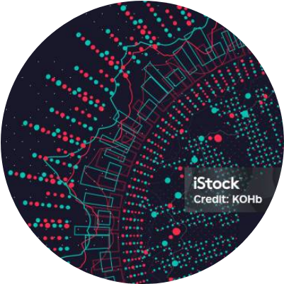
What are Embeddings?
From Text to Mathematics
Embeddings are a numerical representation of text. An embedding model translates human sentences into high-dimensional arrays of numbers (e.g., 384 dimensions).
This allows the database to measure the "distance" between sentences. If a user's query and a document chunk mean the same thing, their vectors will mathematically sit closely together in a 3D space, enabling lightning-fast similarity searches.

Slide 9
Step 2: Retrieval & Generation
Embed User Query: Convert the user's question into a numerical vector using the exact same embedding model used in data ingestion.
Similarity Search: The Vector Database compares the query vector to stored chunks and returns the top matches.
Context Augmentation: Pack the original query AND the retrieved chunks into a system prompt.
LLM Generation: The LLM reads the context, synthesizes the information, and generates an accurate, hallucination-free answer.

Slide 10
Questions?
RAG enables accuracy, privacy, and efficiency for AI.

Slide 11


Image Sources
https://www.yfiles.com/_astro/graph-aggregation.D9Eh-gAD_Z2r066f.png
Source: www.yfiles.com
https://media.istockphoto.com/id/899822874/vector/abstract-3d-big-data-visualization-futuristic-infographics-design.jpg?s=612x612&w=is&k=20&c=gtUnCA6UhUmYP1oFZVUp5dWRuSorHFHuaip2ReXvGgQ=
Source: www.istockphoto.com

